Slide 1

Problems on Confidence Interval 2018

Slide 2
Reference
Data
Youtube
Code

Slide 3
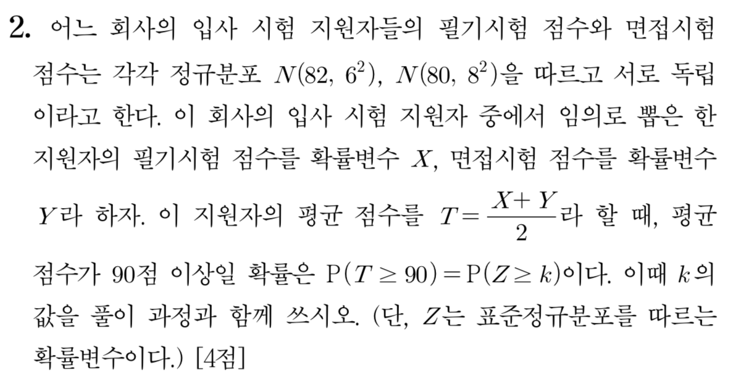
[2018]

Slide 4
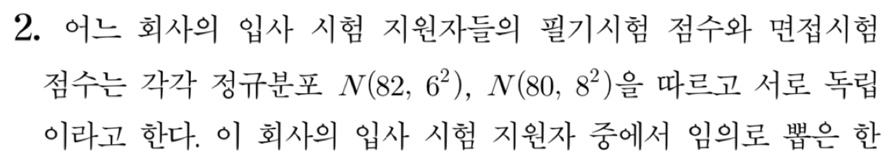

Slide 5
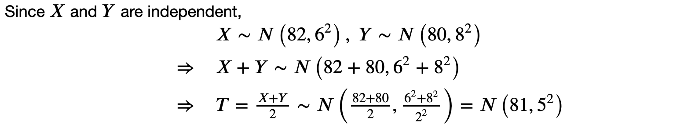


Slide 8

